Slide 2
Introduction
Md. Ashraful Islam Prodhan
Assistant Teacher (English)
Khuksia Dakhil Madrasha
Gobindagonj , Gaibandha.
Email: ashrafulis1984@gmail.com
Mobile: 01744667140
English 2nd Paper
Class – Six
Time – 50 Minute

Slide 3
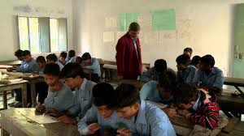
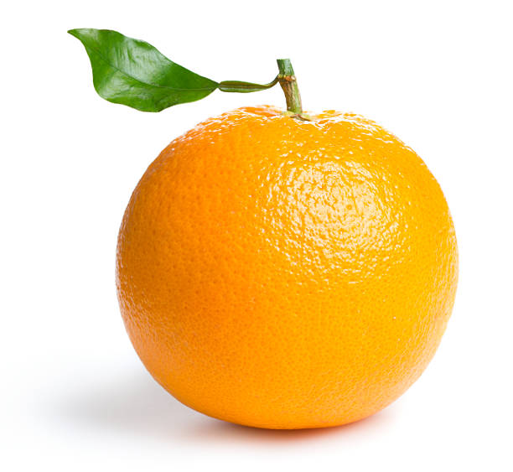
Look at the underlined words in the following sentences:
A teacher teaches his students.
An orange is a delicious fruit.

Slide 4
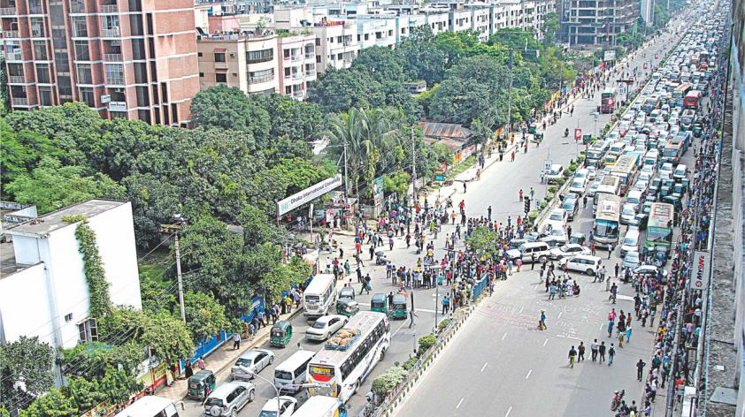
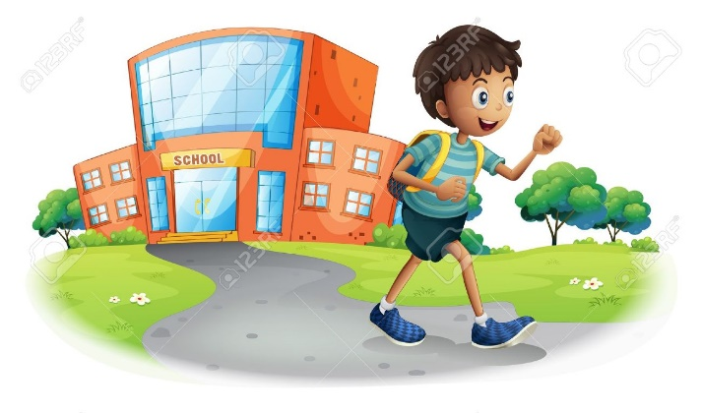
Rajshahi is an old city.
Our class teacher dislikes the naughty boy.
What do the underlines say ?
Articles

Slide 5
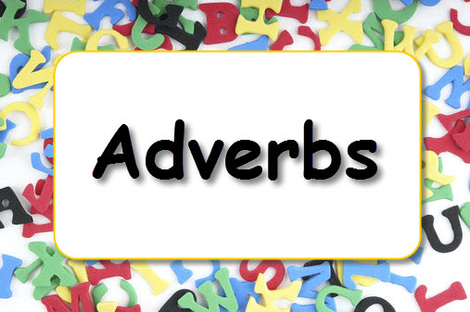
Our today’s lesson is-
Articles

Slide 6
Learning outcomes
At the end of the lesson, we will be able to—
define Article.
Say the features and kind of Article.
Identify the Article in given sentence.
Proper use of Article.

Slide 7
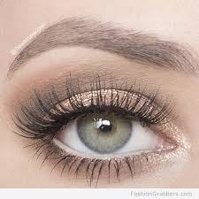
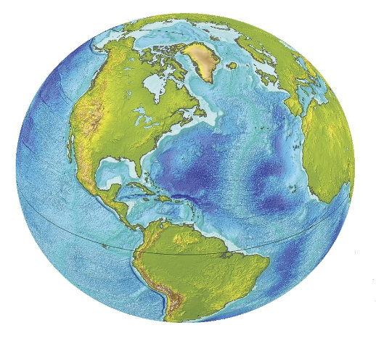
Definition:
Articles: The three words ‘a’ ‘an’ and ‘the’ are called articles , These are also Demonstrative Adjectives . Such as -
A ball.
An eye.
The earth.

Slide 8
Kinds of Articles:
Article
Definite
Indefinite
The
A, An

Slide 9
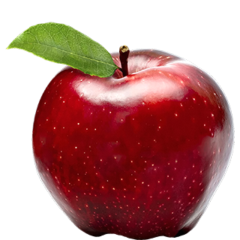
Indefinite articles:
A and an are Indefinite articles. Such as -
I have a book.
This is an apple

Slide 10
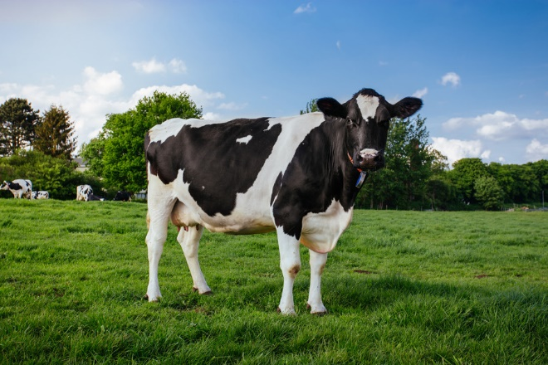
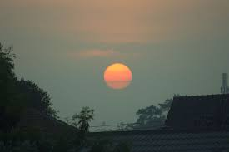
Definite articles:
The is a definite article. Such as -
The cow is a domestic animal.
The sun rises in the east.

Slide 11
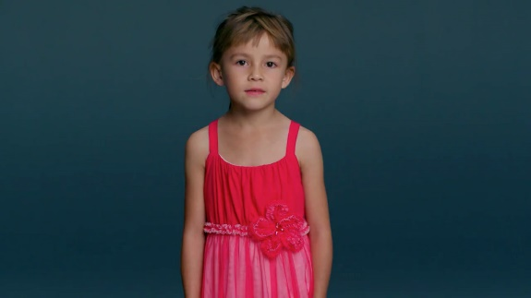
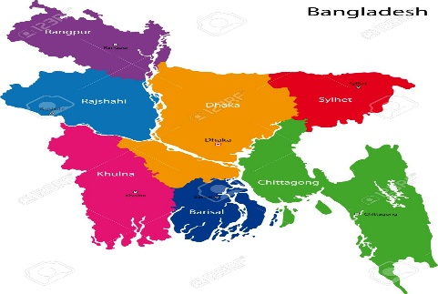
Different uses of ‘a’/’an’:
Observe the following words that have taken ‘a’ before them:
a girl, a boy, a pen, a ball, a bat, a field, a school, a district, a country, a box, a student, a teacher, a word.
A girl.
A school.
A country.
The words that begin with a consonant sound take the article ‘a’ in front of them.

Slide 12
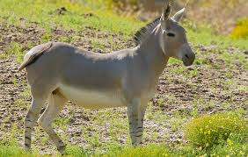
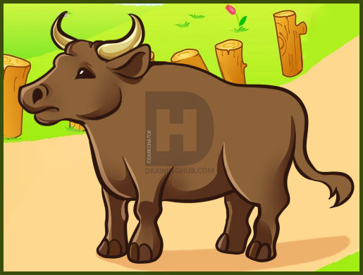
Guess why the following words have taken ‘an’ before them:
An ox, an apple, an umbrella, an orange, an independent country, an interesting film, an eye, an enemy, an ass.
An ass.
An ox.
‘An’ is used before the words that begin with a vowel sound.

Slide 13
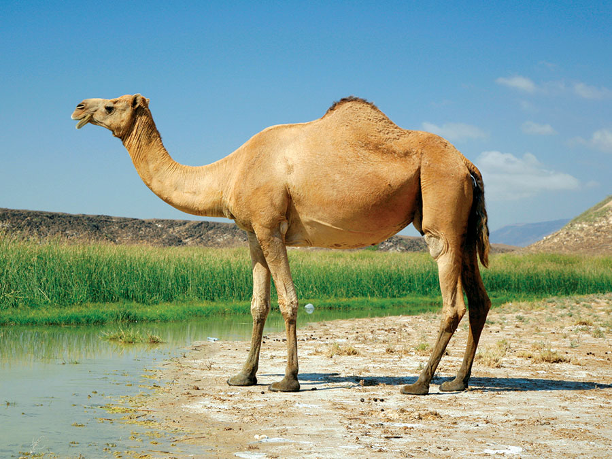
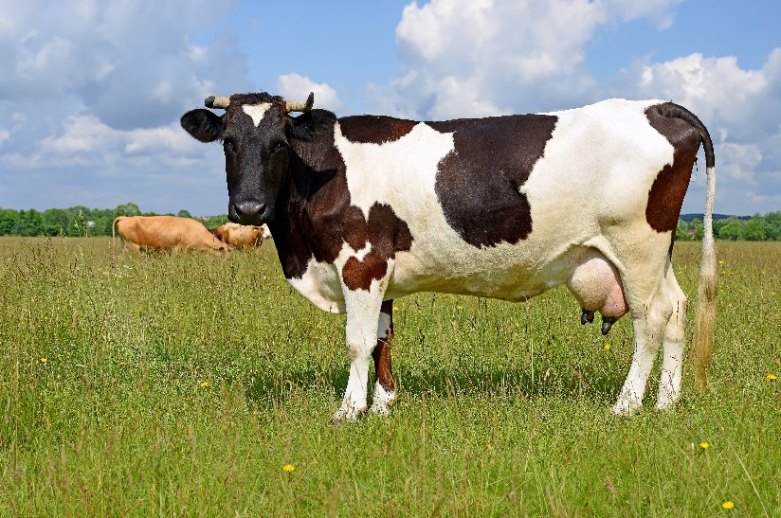
Different uses of ‘the’
The cow is a domestic animal.
The camel is a useful animal.
‘The’ is used before the above singular common nouns to represent the whole classes of these common nouns.

Slide 14
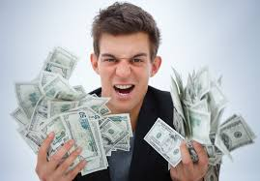
‘The’ is used before adjectives to mean the whole of a particular class.
The rich are not always happy.
The virtuous are always happy.

Slide 15
Individual work
Insert appropriate articles in the blanks in the following sentences :
I saw – one-eyed beggar.
The girl has eaten - orange.
Aristotle was one of – wisest men who ever lived.
He is - M.A.
Dr. Islam is - F. R. C. S.

Slide 16
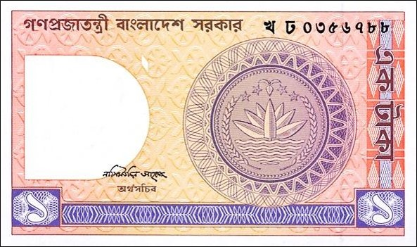
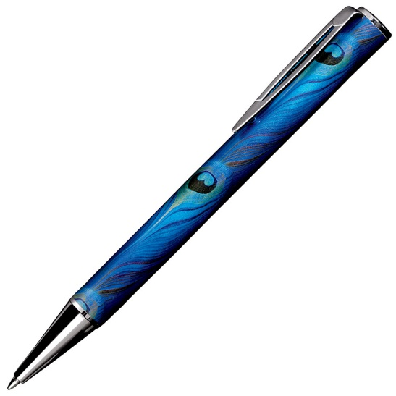
Give me a one taka note.
This is a pen.

Slide 17
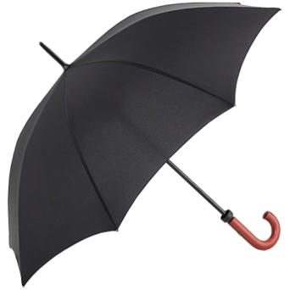
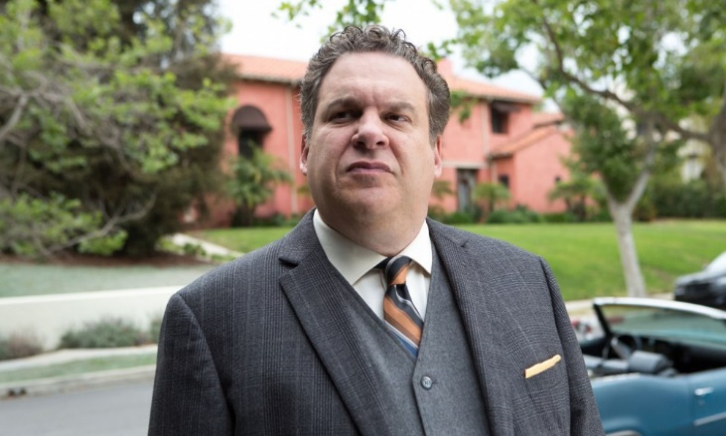
I have an umbrella.
He is an honest man.

Slide 18
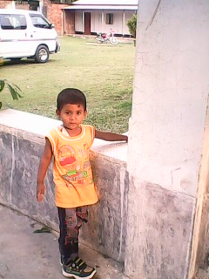
The book you want is out of print
He is the best boy in the class.

Slide 19
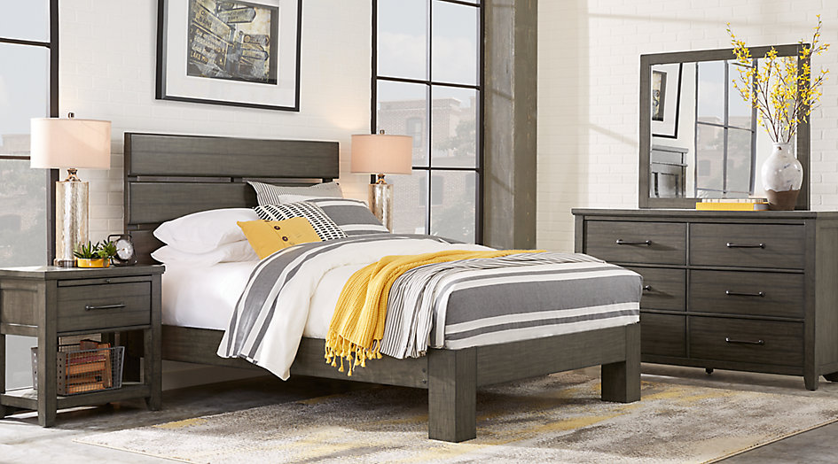
This is Asma Ahmed’s bed room. The room is very neatly made. It has a bed with pillows, cushions, and a colorful, flowery bed-cover. There’s a rug in front of the bed with another big cushion. An excellent painting of the sea is hanging from the wall while another small painting is kept on the top of the right side-table. The room has a rocking chair and a sofa at the left corner. The windows are covered with large heavy curtain. Can you see a mask somewhere around the bed.
The bold words in the passage are examples of articles in English. Can you find out any principle or rule about the use of a, an and the in the passage Use of articles.

Slide 20
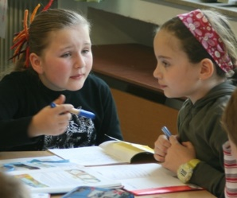
Pair work
Correct the following :-
He is a honest man.
She reads a Quran daily.
Dog is an useful animal.
Always speak truth.
This is unique position.

Slide 21
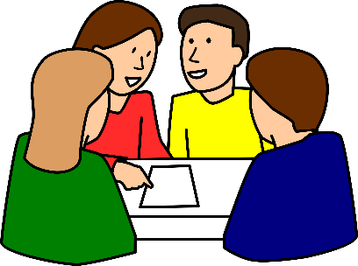
Group work
Use articles, where necessary, in the following sentences:
Group – 1 : (a) She is most intelligent girl.
(b) I want one taka note.
Group - 2 : (a) Do not make noise.
(b) He is honest boy.
Group – 3 : (a) I read Ittefaq everyday.
(b) She ate apple.

Slide 22
Evaluation
Fill in the gaps with articles:
Dhaka is ---- old city.
This is ---- book.
He is --- best boy in the class.
Answer key: (1) an , (2) a , (3) the .

Slide 23
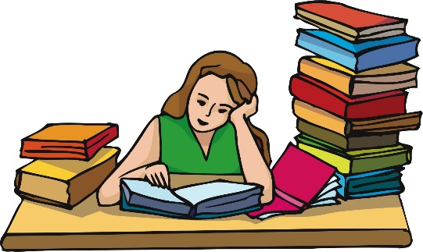
Home work
Write the following questions and answer them:
What is Article?
How many types of Article?

